Slide 1
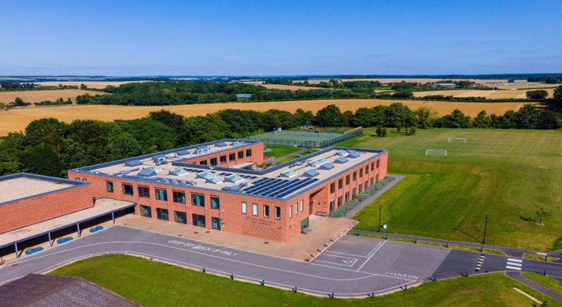
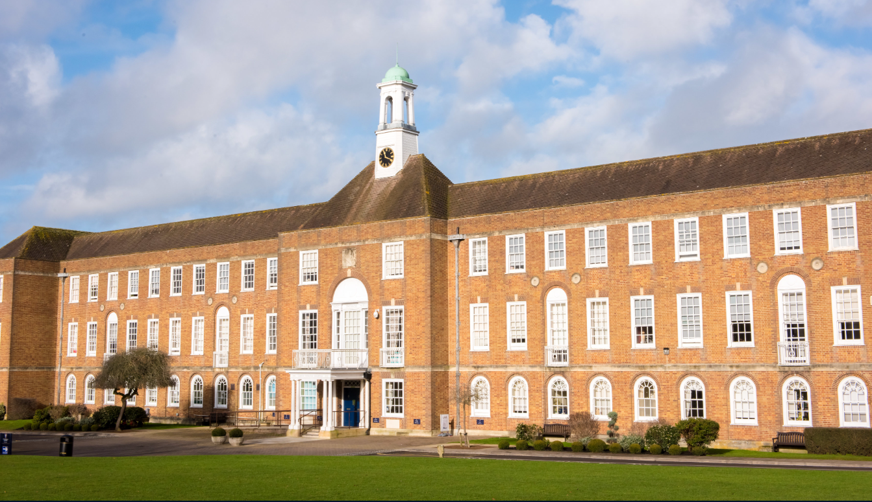

Lifeguard
Required from January 2025
Full time (40 hours per week)
£24,807 per year

Slide 2
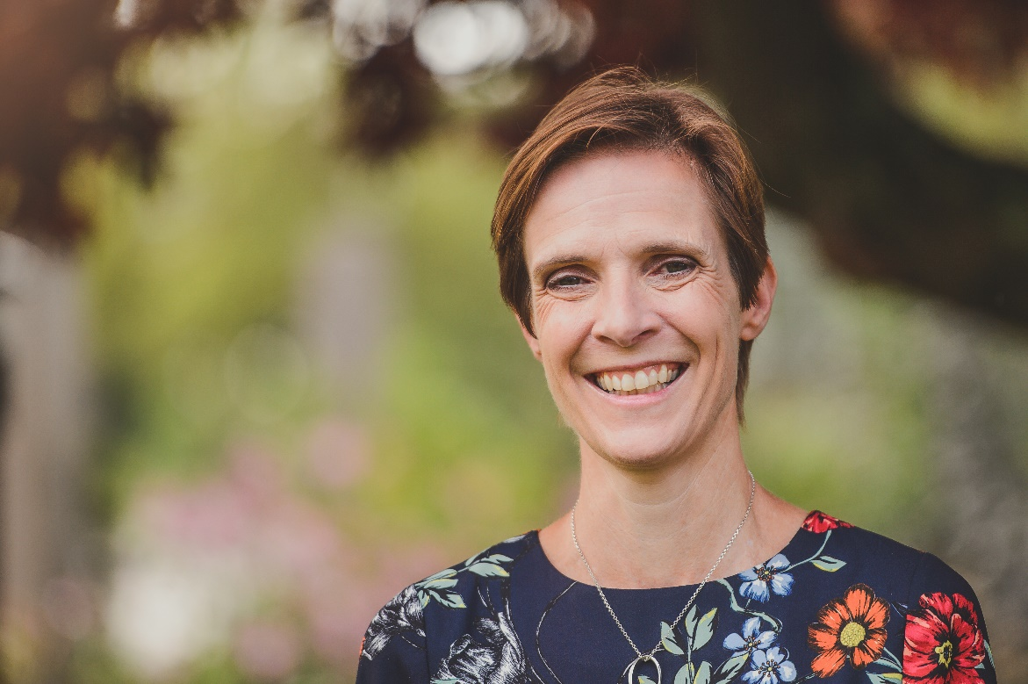
Welcome from the headmistress
Thank you for your interest in St Swithun’s.
We are proud to be a High Performance Learning School and a member of the Fellowship of World Class Schools. The High Performance Learning philosophy is that: high achievement is an attainable target for everyone; intelligence is not fixed (we can all become cleverer); high performers are made, not born (they work for it). HPL involves the systematic and explicit encouragement and empowerment of students to develop the ways of thinking and ways of behaving that will equip them for success both in school and beyond. It is the cornerstone of our philosophy.
We are also a girls’ school and as such we expect and support all our students to enjoy and excel in a range of subjects and activities according to their interests and not their gender. We seek to be free from unhelpful stereotyping and to offer genuinely limitless education.
Further, we are a high trust community and we try always to behave with a seriousness of intention and a lightness of touch. We believe the best of staff and students and often see our expectations exceeded and a joke cracked along the way.
If this short introduction resonates with you, we would very much welcome an application from you.
Jane Gandee, headmistress

Slide 3
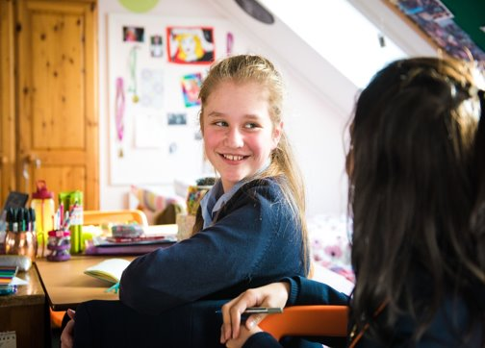
Our school
St Swithun’s School, Winchester is a leading GSA and HMC school offering day, weekly boarding and full boarding for 520 girls aged 11-18.
The girls benefit from excellent teaching, sporting and recreational facilities. St Swithun’s is academically selective and regularly appears in the top 30 schools in the national league tables.
There is also an adjoining IAPS Prep School for girls aged 3-11 with a co-educational nursery.
Our location
The school is set on an campus of 45 acres overlooking the Hampshire Downs and within the South Downs National Park. The school is within walking distance of the centre of Winchester, and only a 50-minute journey from central London.
Winchester and its surrounding areas offer outstanding local cultural, historical, sporting and entertainment opportunities in addition to fantastic access to outdoor pursuits. Southampton, Portsmouth, Salisbury and Bournemouth are all easily accessible on public transport.

Slide 4
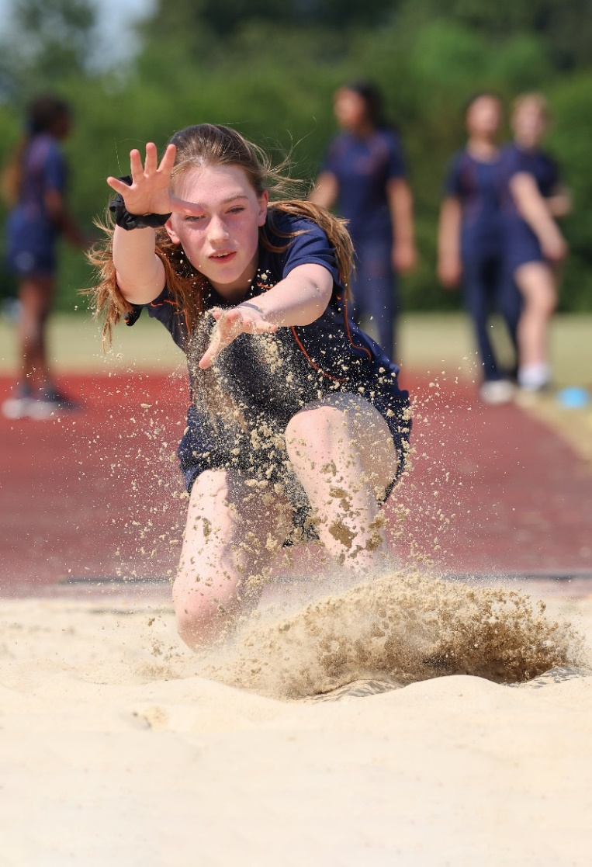
Our ethos
St Swithun’s is an appropriately academic school which means that we celebrate intellectual curiosity and the life of the mind, but not to the exclusion of all else. We expect our pupils to develop individual passions and through them to acquire a range of skills and characteristics. These characteristics will include a willingness to take risks, to question and to debate, and to persevere in the face of difficulty. In the words of Samuel Beckett: “Ever tried. Ever failed. No matter. Try again. Fail again. Fail better.” If a girl can immediately excel at everything we ask of her, we as educators must set the bar higher.
We want all pupils to learn about life beyond the school gates, to appreciate the rich variety of our world, to develop an understanding of compassion and to value justice. We encourage all pupils to become involved in fundraising and community work. They should appreciate how their decisions and their actions can affect those around them.
By the time a pupil leaves St Swithun’s she will be well-educated, courageous, compassionate, committed and self-confident with a love of learning, a moral compass and a sense of humour.

Slide 5
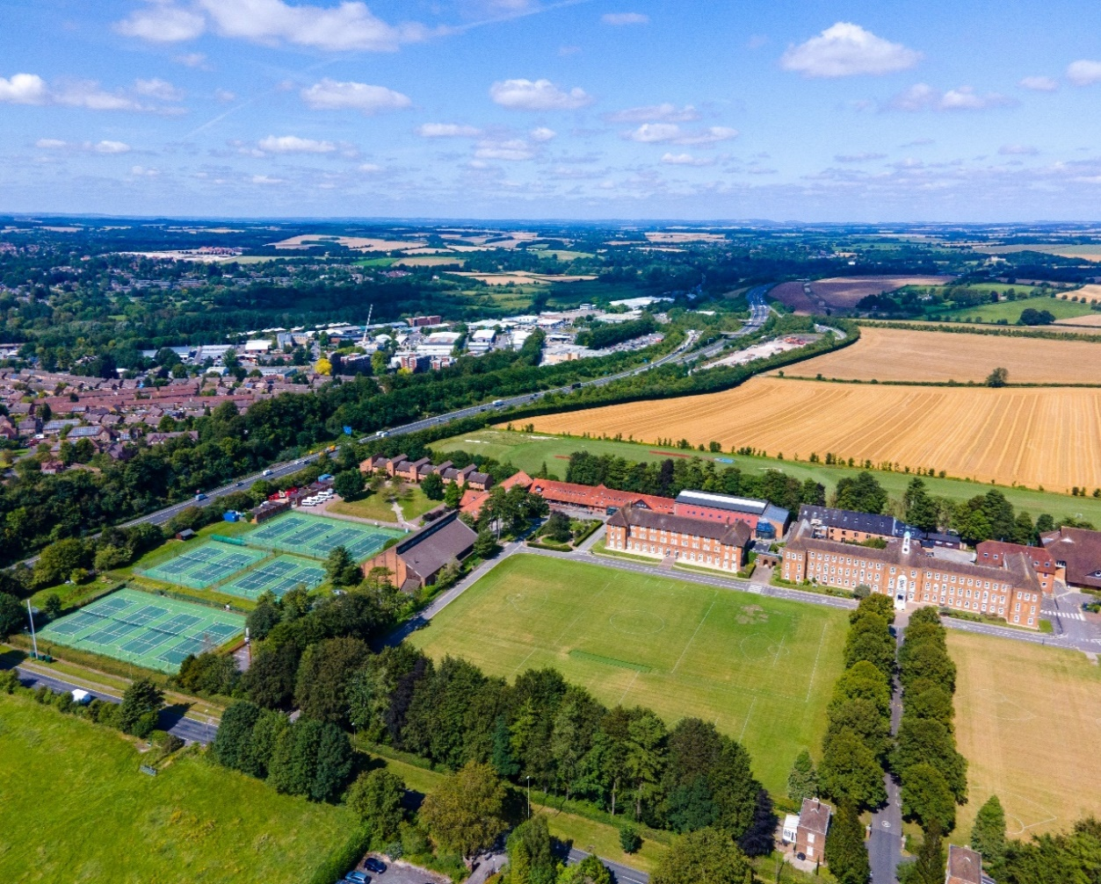
Our facilities
The school offers girls excellent teaching, sporting and recreational facilities. The school buildings are modern and well equipped. As well as the normal academic classrooms and science laboratories, there is a magnificent performing arts centre with a 600-seat auditorium, a music school, an art and technology block, a sports hall and a full-size swimming pool. There is an impressive library, higher education and student guidance department and ICT facility. The grounds are spacious and encompass sports fields, tennis courts and gardens.
The senior school has six boarding houses for full and weekly boarders, with separate houses for those in their first and second years and those in the upper sixth.
The School is registered as a Company Limited by Guarantee and as a Charity, and it has a wholly owned subsidiary company (St Swithun’s School Letting Company Limited).
Further details of the School can be found at www.stswithuns.com

Slide 6
Lifeguard
We are seeking a reliable, self-motivated Lifeguard to join our pool team full-time. You will work various shifts on a three-week rolling rota which will include early morning, evening and weekend working. The opportunity to undertake duty management training may be available for the right candidate.
Our Lifeguards must hold a current NPLQ. The school may be willing to support the successful candidate to obtain this if they don’t have a current certificate; they would need to meet the pool competency aspects of the role for this to be considered.
We have a full sized 25 metre swimming pool as well as a learner pool, housed in a purpose built building with changing rooms and a viewing gallery.
The swimming pool is used extensively by the school for PE classes and swim squad training, as well as being regularly available for lettings, and use by community members.
The swimming pool is staffed by a pool manager, deputy manager, duty managers and a large team of full time, part time and casual lifeguards.

Slide 7
Lifeguard
Key requirements of the role, the following is not a definitive list but gives an overall view of the role that a lifeguard will undertake:
Health and Safety
Maintain vigilant supervision of pool users and ensure their safety at all times
Administer first aid, effect pool rescues and carry out resuscitation as necessary
Maintain any suggested training requirements
Continually meet the lifeguard key performance indicators and competency standards
To administer first aid, effect pool rescues and carry out resuscitation as necessary
Ensure that all Centre equipment is stored safely and securely
General
Ensure the comfort, safety and enjoyment of all users of the Centre
To help customers in a friendly and professional manner
Carry out cleaning duties as necessary
Carry out patrols of the Centre
Supporting teaching staff where necessary
Assisting the Duty Manager with any tasks involved in the operation of the Centre
Safeguarding
Promote and safeguard the welfare of children and young persons for who you are responsible and with whom you come into contact
Report any matter of concern to the Duty Manager immediately

Slide 8
Person specification
Safeguarding
All pool staff must promote and safeguard the welfare of children and young persons for who you are responsible and with whom you come into contact
All pool staff must report any matter of concern to the Duty Manager immediately
Essential | Desirable
A current NPLQ – or willingness to obtain (for the right candidate the school may finance this qualification) | A good working knowledge of IT packages including Outlook, and experience of using databases
Good verbal and written communication skills | Experience of working in a customer facing role
Flexibility in approach to work – willingness to adapt and support colleagues as required | Experience of working with children / young people
Ability to work constructively in a team but also be self-motivated to complete tasks alone

Slide 9
Terms and conditions and application process
TERMS AND CONDITIONS
This is a permanent, full-time position (40 hours per week).
The post holder will need to be available to work a mixture of shifts on a three-week rolling rota which will include early mornings, evenings and weekends.
The initial salary will be £24,807 per year. The post holder will be entitled to 5.6 weeks of paid holiday (including bank holidays – if a bank holiday is a working day, a day off will be given at another time).
The school offers a range of other benefits including:
Generous contributory pension scheme
Membership of the swimming pool
Discount on school fees
Refreshments whilst working, and free meals when required to be at work over a mealtime during term time
APPLICATION
The closing date for applications is
9.00am on 2 January 2025.
Applications will be considered as they are received and we reserve the right to close applications before the closing date.
Please complete our online application form which can be found here.
For any queries about the role or the application process, please contact the HR Department:
Telephone: 01962 835798
Or email: recruitment@stswithuns.com

Slide 10
Child protection and safeguarding
“St Swithun’s is committed to safeguarding and promoting the welfare of children.
All staff are expected to share and support this commitment and applicants must be willing to undergo child protection screening appropriate to the post, including checks with past employers
and the Disclosure & Barring Service.”
Child Protection Statement
Every child has the right to freedom from physical, racial, sexual, verbal or mental abuse (this includes bullying and intimidation). Our overriding aim is the protection of the individual child within the school.
We require staff to be fully aware of what child abuse is and the different forms in which it may present itself, and of their duties in respect to child protection.
We will provide adequate training (both as part of an induction and an ongoing process) in recognising abuse, and what to do if abuse is suspected.
We are committed to maintaining good communication within the School on child protection issues and to following recognised procedures.
The Head ensures that the recommended procedures are followed when recruiting staff.

Slide 11
Equal opportunities
St Swithun’s welcomes applications from candidates from a diverse range of backgrounds. The school will recruit predominantly based on an applicant’s relevant skills, experience, capabilities and potential for development. The ability to work collaboratively with others will also be taken into account.
St Swithun's is committed to promoting equality of opportunity for all staff and job applicants. We aim to create a working environment in which all individuals are able to make best use of their skills free from unlawful discrimination or harassment, and in which all decisions are based on merit (apart from in any necessary and limited exemptions and exceptions allowed under the Equality Act).
We do not discriminate unlawfully on the basis of age, disability, marital or civil partner status, race (including nationality, ethnic or national origin), religion or belief, sex or sexual orientation, gender reassignment or pregnancy or maternity (defined in the Equality Act 2010 as protected characteristics).
If you have questions about our recruitment processes, or would like any support to access our recruitment process fully please do contact us at recruitment@stswithuns.com.

Slide 12
Explanatory notes
Application form ​
Applications will only be accepted from candidates completing the enclosed application form in full. CVs will not be accepted in substitution for completed application forms.​
Candidates should be aware that all posts in the school involve some degree of responsibility for safeguarding children, although the extent of that responsibility will vary according to the nature of the post. Please see the job description for the post.​
Accordingly this post is exempt from the Rehabilitation of Offenders Act 1974 and therefore all convictions, cautions and bind-overs, including those regarded as ‘spent’ must be declared.​
The successful applicant will be required to complete a disclosure application form from the Disclosure and Barring Service.​
In accordance with government guidelines, we will seek references on shortlisted candidates for teaching and some other posts, and approach previous employers for information to verify particular experience or qualifications before interview. In other cases, if this has not been done, any offer of a post will be conditional upon receipt of satisfactory references. References should be from the applicant’s current or most recent employer. If the current/most recent employer does/did not involve work with children, then the second reference should, if possible, be from the employer with whom the applicant most recently worked with children. Referees should not be a relative or someone known to the applicant solely as a friend.​
If you are currently working with children, on either a paid or voluntary basis, your current employer will be asked about disciplinary offences, including disciplinary offences relating to children or young persons (whether the disciplinary sanction is current or time expired), and whether you have been the subject of any child protection allegations or concerns and if so, the outcome of any enquiry or disciplinary procedure. If you are not currently working with children, but have done so in the past, that previous employer will be asked about those issues. Where neither your current nor previous employment has involved working with children, your current employer will still be asked about your suitability to work with children, although they may, where appropriate, answer not applicable if your duties have not brought you into contact with children or young persons. The School will only accept references obtained directly from the referee and will not rely on references provided by the applicant or on open references or testimonials.​
You should be aware that provision of false information is an offence and could result in the application being rejected or summary dismissal if the applicant has been selected, and possible referral to the police and/or DfES Children’s Safeguarding Operation Unit.

Slide 13
Explanatory notes
Invitation to Interview ​
If you are invited to interview, this will be conducted in person and the areas which it will explore will include suitability to work with children.​
All candidates invited to interview must bring documents confirming any educational and professional qualifications that are necessary or relevant for the post (e.g. the original or certified copy of certificates, diplomas, etc.). Where originals or certified copies are not available for the successful candidate, written confirmation of the relevant qualifications must be obtained from the awarding body. All candidates invited to interview must also bring with them: ​
At least two forms of identification, i.e. current driving licence (including photograph), a passport, a full birth certificate or marriage certificate, a utility bill or financial statement showing the candidate’s current name and address. These must be issued within the last three months and provide verification of address. Documentation confirmation their national insurance number, where appropriate, any documentation evidencing a change of name.​
Please note that originals of the above are necessary - photocopies or certified copies are not sufficient.​
Any offer to a successful candidate will be conditional upon: ​
Receipt of at least two satisfactory references (if these have not already been received). ​
A check of the DfES barred list database and the Protection of Children Act List as appropriate. ​
A satisfactory DBS disclosure. ​
Where the successful candidate has worked or been resident overseas in the previous ten years, such checks and confirmations as the school may require in accordance with statutory guidance.​
Satisfactory completion of the probationary period.​
Verification of medical fitness appropriate for the job’s requirements.​
A written declaration that neither they nor anyone in their household is disqualified from working with children.​
Verification of professional status, such as GTC registration, QTS Status (where required), NPQH. ​
Verification that the teacher/applicant is not subject to a prohibition order issued by the Secretary of State. ​
Verification of successful completion of statutory induction period (applies to those who obtained QTS after 7 May 1999).

