Slide 1
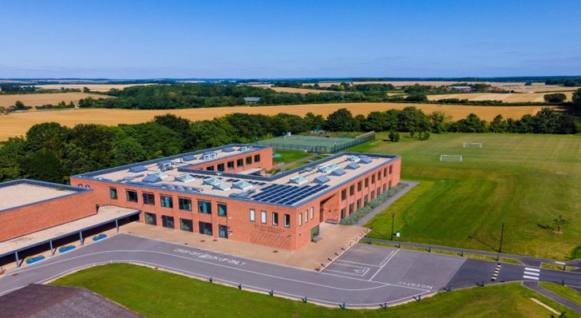
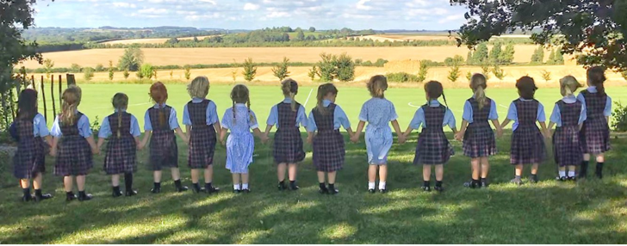
Prep PE Teacher (temporary contract)
Required as soon as possible
Full time

Slide 2
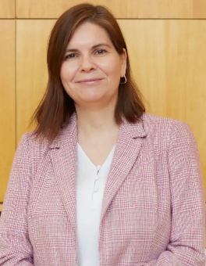
Welcome from the Prep School Head
Thank you for your interest in us!
We are a lively, forward-thinking prep school which takes great pride in introducing children to as many experiences as possible. We want our children to have fun as they learn, and our curriculum ensures they have plenty of opportunities for learning and discovery.
We are looking for an enthusiastic PE teacher to join us temporarily covering a period of maternity leave. The successful candidate will enjoy being a team-player and be passionate about competitive sport, but also about the importance of active wellbeing for all children.
We hope this pack helps you see what is important to us here at St Swithun’s. We would very much welcome your application and look forward to meeting you.
Liz Norris, Prep School Head

Slide 3
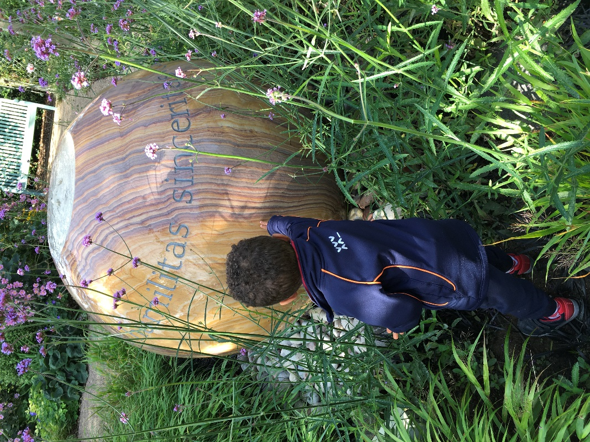
Welcome to our school
St Swithun’s Prep School in Winchester accommodates 230 girls aged 4-11 with a co-educational pre-school from age 3. The prep school is housed in a pair of state of the art buildings that opened in 2015 and 2016. The main block houses classrooms alongside specialist areas for Art and Design Technology, Computing, Food Technology, Science and Music. The adjacent building contains a Gym and a multi-purpose auditorium with retractable tiered seating.
The Prep School adjoins St Swithun’s Senior School, a leading GSA school offering day, weekly boarding and full boarding for 520 girls aged 11-18. Many facilities are shared, including catering facilities and a swimming pool complex that includes separate full-size and learner pools.
The schools are set on an impressive and attractive campus of 45 acres overlooking the Hampshire Downs and within the South Downs National Park. The school is within walking distance of the centre of Winchester, and only an hour from central London.

Slide 4
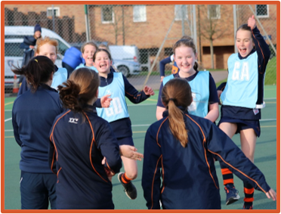
About St Swithun's Prep
At St Swithun’s prep school, children's happiness is at the heart of everything we do. We know that confidence is fundamental to success, so all activities are characterised by a palpable sense of fun and enjoyable challenge to ensure that pupils flourish in every way during their time with us.
Children here all enjoy a huge range of opportunities to shine wherever their interests lie; they are guided to give their very best, astonish their audiences and receive their applause. They are the leaders of tomorrow, and it is an enormous honour and privilege to be a key influence in their development.
Whilst gently selective and keenly focussed on intellectual rigour, we offer a genuine all-round education and we place enormous importance on celebrating diversity in everything that we do. We offer an inclusive, yet appropriately competitive, sports programme and we encourage children to have fun, take risks and get stuck in to all that we have on offer.

Slide 5
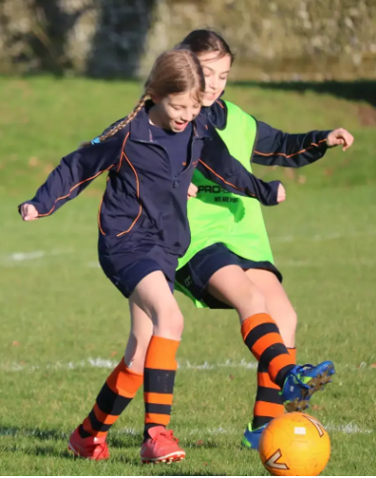
High Performance Learning
We are proud to be a High Performance Learning School and a member of the Fellowship of World Class Schools.
The High Performance Learning philosophy is that:
high achievement is an attainable target for everyone;
intelligence is not fixed (we can all become cleverer);
high performers are made, not born (they work for it).
HPL involves the systematic and explicit encouragement and empowerment of students to develop the ways of thinking and ways of behaving that will equip them for success both in school and beyond. It is the cornerstone of our philosophy.
We are also a girls’ school and, as such, we expect and support all our pupils to enjoy and excel in a range of subjects and activities according to their interests and not their gender. We seek to be free from unhelpful stereotyping and to offer genuinely limitless education.

Slide 6
PE Teacher
The school is seeking to appoint an enthusiastic PE and games teacher to play a full and active role within our dedicated sports department. This is a full-time role on a temporary basis to cover for a period of maternity leave. Our PE teachers deliver specialist instruction across the full prep school age range from Preschool through to Year 6.
A particular focus for this post will be netball coaching for the older year groups but there will also be extensive opportunities for other outdoor sports (including football and cricket) as well as gym, dance, athletics and swimming.
The below list sets out the main roles and responsibilities of the post.
Teaching
Delivering high-quality lessons that ensure development and strong levels of pupil engagement and enjoyment, across all key stages.
Focusing on individuals to ensure differentiation is appropriate and supports inclusion.
Maintaining a purposeful and focused atmosphere and setting the highest expectations of behaviour and attitudes to learning.
Keeping informed about best practice in teaching, coaching and learning as well as any curriculum or sports body changes.
Ensuring communication with parents, pupils and staff is effective and professional at all times and supports the wider vision and aims of the school.

Slide 7
PE teacher: responsibilities
Key requirements of the role continued:
Liaising with the SENDCo, as appropriate, to ensure the best possible provision for pupils with SEND.
Following the school’s policies on tracking pupil progress and reporting to parents.
Other Duties
Leading and umpiring school fixtures, which may be in the evenings or at the weekend.
Running co-curricular sports clubs, attending school trips, matches, tournaments and, as required, residential trips.
Carrying out supervisory duties as part of the school rota.
Attending meetings, training, INSET, assemblies and occasional events such as the school fête, as required.
Meeting all deadlines for the efficient running of the school (e.g. reports, planning, work scrutiny submissions).
General
All staff are expected to promote and safeguard the welfare of children and young people, comply with the school’s Safeguarding policy and adhere to all other policies set out by the school.
All staff must comply with the staff behaviour policy, setting exemplary standards of behaviour, appearance and attitude.
Staff may be asked to undertake other duties which may, from time to time, be reasonably requested by the Prep School Head and SLT.

Slide 8
PE Teacher: knowledge & experience
Essential | Desirable
QTS and a university degree | Enthusiastic participation in sport outside school
Passion for sport, wellbeing and a healthy lifestyle | Experience of EYFS, KS1 and KS2
Excellent PE knowledge across the primary age range | Swimming teaching qualifications and experience
Knowledge of statutory responsibilities including safeguarding | Experience teaching and umpiring netball
Experience of planning engaging lessons that enable high quality learning and a love of sport | Experience teaching in both maintained and independent schools
Experience of using a range of tools and data to support the progress and achievement of pupils | Paediatric first aid qualification

Slide 9
PE Teacher: key skills & qualities
Excellent teaching methods with consistently strong demonstrable outcomes for pupils
Outstanding communication skills (with excellent spoken and written English)
The ability to work collaboratively and effectively as part of the wider school team
The ability to problem-solve and calmly support others to overcome challenges
The ability to manage workload, time and complex demands effectively
A firm commitment to the safeguarding and protection of children and young people
Appreciation for the values of independent school parents, highly invested in the progress of their children

Slide 10
Role information & application process
ROLE INFORMATION
This is a temporary role to cover for a period of maternity leave. We are keen for someone to join us at any point during the spring term. The role is required full-time, but a 0.8 timetable spread across five days may be possible.
The school offers a range of benefits including:
Choice of TPS of a generous DC pension scheme
Free membership of the school swimming pool
Private medical insurance
Discount on school fees
Access to free or heavily subsidised wellbeing activities
Refreshments and meals whilst working
APPLICATION INFORMATION
​
The closing date for applications is ​Thursday 2 January 2025, 9am.
Early applications are encouraged - we will be reviewing applications as they are received and reserve the right to appoint before the closing date.​
​
Please complete our online application form which can be found here.
​
If you have any questions about the role or the application process please contact the HR department:
Telephone: 01962 835798​
Email: recruitment@stswithuns.com

Slide 11
Child protection and safeguarding
“St Swithun’s is committed to safeguarding and promoting the welfare of children.
All staff are expected to share and support this commitment and applicants must be willing to undergo child protection screening appropriate to the post, including checks with past employers and the Disclosure & Barring Service.”
Child Protection Statement
Every child has the right to freedom from physical, racial, sexual, verbal or mental abuse (this includes bullying and intimidation). Our overriding aim is the protection of the individual child within the school.
We require staff to be fully aware of what child abuse is and the different forms in which it may present itself, and of their duties in respect to child protection.
We will provide adequate training (both as part of an induction and an ongoing process) in recognising abuse, and what to do if abuse is suspected.
We are committed to maintaining good communication within the School on child protection issues and to following recognised procedures.
The Head ensures that the recommended procedures are followed when recruiting staff.

Slide 12
Equal opportunities
St Swithun’s welcomes applications from candidates from a diverse range of backgrounds. The school will recruit predominantly based on an applicant’s relevant skills, experience, capabilities and potential for development. The ability to work collaboratively with others will also be taken into account.
St Swithun's is committed to promoting equality of opportunity for all staff and job applicants. We aim to create a working environment in which all individuals are able to make best use of their skills free from unlawful discrimination or harassment, and in which all decisions are based on merit (apart from in any necessary and limited exemptions and exceptions allowed under the Equality Act).
We do not discriminate unlawfully on the basis of age, disability, marital or civil partner status, race (including nationality, ethnic or national origin), religion or belief, sex or sexual orientation, gender reassignment or pregnancy or maternity (defined in the Equality Act 2010 as protected characteristics).
If you have questions about our recruitment processes, or would like any support to access our recruitment process fully please do contact us at recruitment@stswithuns.com.

Slide 13
Explanatory notes
Application form ​
Applications will only be accepted from candidates completing the enclosed application form in full. CVs will not be accepted in substitution for completed application forms.​
Candidates should be aware that all posts in the school involve some degree of responsibility for safeguarding children, although the extent of that responsibility will vary according to the nature of the post. Please see the job description for the post.​
Accordingly this post is exempt from the Rehabilitation of Offenders Act 1974 and therefore all convictions, cautions and bind-overs, including those regarded as ‘spent’ must be declared.​
The successful applicant will be required to complete a disclosure application form from the Disclosure and Barring Service.​
In accordance with government guidelines, we will seek references on shortlisted candidates for teaching and some other posts, and approach previous employers for information to verify particular experience or qualifications before interview. In other cases, if this has not been done, any offer of a post will be conditional upon receipt of satisfactory references. References should be from the applicant’s current or most recent employer. If the current/most recent employer does/did not involve work with children, then the second reference should, if possible, be from the employer with whom the applicant most recently worked with children. Referees should not be a relative or someone known to the applicant solely as a friend.​
If you are currently working with children, on either a paid or voluntary basis, your current employer will be asked about disciplinary offences, including disciplinary offences relating to children or young persons (whether the disciplinary sanction is current or time expired), and whether you have been the subject of any child protection allegations or concerns and if so, the outcome of any enquiry or disciplinary procedure. If you are not currently working with children, but have done so in the past, that previous employer will be asked about those issues. Where neither your current nor previous employment has involved working with children, your current employer will still be asked about your suitability to work with children, although they may, where appropriate, answer not applicable if your duties have not brought you into contact with children or young persons. The School will only accept references obtained directly from the referee and will not rely on references provided by the applicant or on open references or testimonials.​
You should be aware that provision of false information is an offence and could result in the application being rejected or summary dismissal if the applicant has been selected, and possible referral to the police and/or DfES Children’s Safeguarding Operation Unit.

Slide 14
Explanatory notes
Invitation to Interview ​
If you are invited to interview, this will be conducted in person and the areas which it will explore will include suitability to work with children.​
All candidates invited to interview must bring documents confirming any educational and professional qualifications that are necessary or relevant for the post (e.g. the original or certified copy of certificates, diplomas, etc.). Where originals or certified copies are not available for the successful candidate, written confirmation of the relevant qualifications must be obtained from the awarding body. All candidates invited to interview must also bring with them: ​
At least two forms of identification, i.e. current driving licence (including photograph), a passport, a full birth certificate or marriage certificate, a utility bill or financial statement showing the candidate’s current name and address. These must be issued within the last three months and provide verification of address. Documentation confirmation their national insurance number, where appropriate, any documentation evidencing a change of name.​
Please note that originals of the above are necessary - photocopies or certified copies are not sufficient.​
Any offer to a successful candidate will be conditional upon: ​
Receipt of at least two satisfactory references (if these have not already been received). ​
A check of the DfES barred list database and the Protection of Children Act List as appropriate. ​
A satisfactory DBS disclosure. ​
Where the successful candidate has worked or been resident overseas in the previous ten years, such checks and confirmations as the school may require in accordance with statutory guidance.​
Satisfactory completion of the probationary period.​
Verification of medical fitness appropriate for the job’s requirements.​
A written declaration that neither they nor anyone in their household is disqualified from working with children.​
Verification of professional status, such as GTC registration, QTS Status (where required), NPQH. ​
Verification that the teacher/applicant is not subject to a prohibition order issued by the Secretary of State. ​
Verification of successful completion of statutory induction period (applies to those who obtained QTS after 7 May 1999).

